Slide 1

IoT Based Smart Inhaler
For Context-Aware Service Provisioning
Presented by:
Anindo Dey (151014078)
Khendaker Afsanul Haque (161014068)
Supervised by:
Muhammad Golam Kibria, PhD

Slide 2
Overview
This system is basically a service provider for Asthma Patients
IoT Based Health Care
Monitoring Altitude, Physiological & Contextual status for Context-aware provisioning
Context-awareness
Smartly enhanced inhaler connected with Patient’s smartphone application – will act as a life saver for Asthma Patients
Smart Inhaler
2/27

Slide 3
Introduction
Asthma is a clinical condition.
Asthma accounts for about 1 of every 250 deaths worldwide.
Asthma inhalers are prescription medications for asthma symptoms.
An asthma attack can be life-threatening.
It's important to understand the intended use of inhaler.
In addition we are trying to add some services provisioning.
Almost everybody have their smartphones.
A smart system that integrates IoT and Inhaler.
3/27

Slide 4
Objectives
IoT based affordable system for Asthma Patients
to introduce a smart inhaler which acts as a life saver of asthma patients and work on to available in Bangladeshi market that will make the life of asthma patient easier.
Context aware monitoring
monitoring patient’s symptoms and their surroundings, will have finding, several context aware based notification giving part to the user by which they have better control over their disease.
Give the Users much efficiency
Through the development, our main objective is to build an efficient way of living for the Asthma patients.
4/27

Slide 5

Motivation
IoT Based Healthcare
Nowadays IoT is a state of art technology and we wanted to develop a Iot Based Healthcare system which can batter control over the disease – Asthma.
Improve the way of Inhaler medication
Sometimes asthma patient’s can not take or forget to take their inhaler medication timely because of certain reasons, we figure out those reasons and worked on to develop a smart inhaler medication system.
Contribution for Asthma Society
We designed and developed this system in such a way that – local researchers can develop this system in a cheap way and contribute this project to the society.
5/27

Slide 6
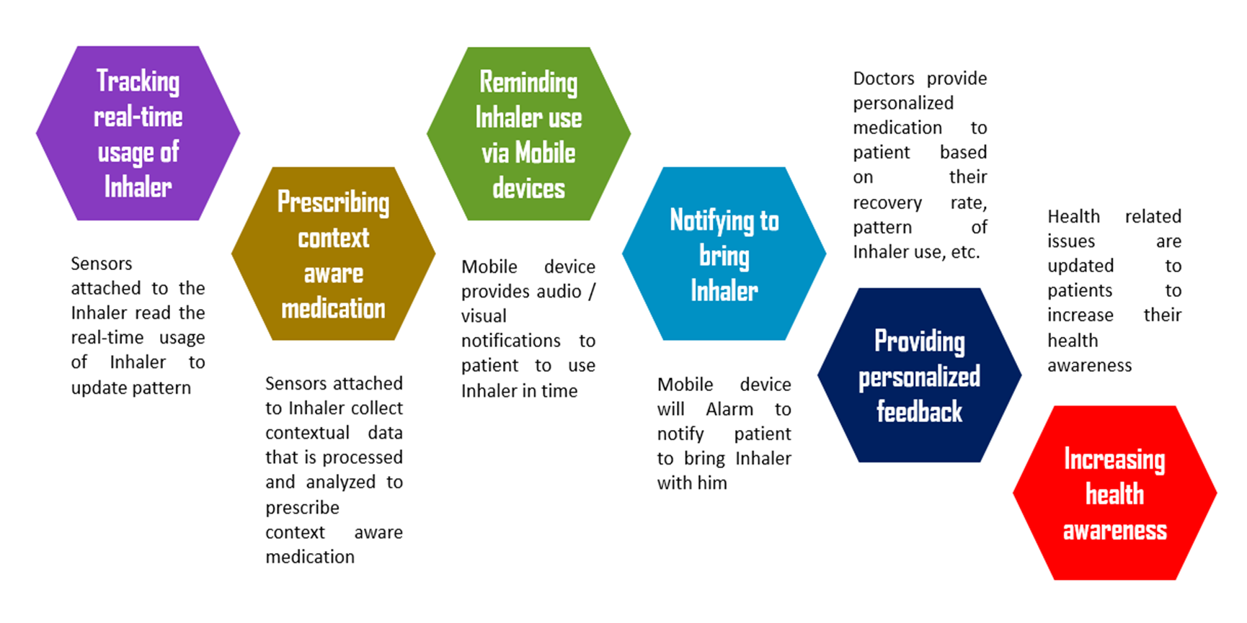
Features of Smart Inhaler System
6/27

Slide 7

Context Awareness
The asthma is so severe that the person's blood oxygen is low (very unusual except during an acute attack), being at altitude or on an air flight would further reduce the blood oxygen level. The dry and often cool conditions experienced at significant altitude might trigger asthma symptoms. Symptoms of illness at altitude include:
01
Migraine
02
Fatigue, Vomit
03
Shortness of Breath,
Fast Heart Rate
The disease asthma doesn’t only depend on the height, also depends on weather, amount of carbon monoxide and other gases mixing in the air, temperature etc.
7/27

Slide 8
Solutions
01
02
03
Notify
Prediction
Suggestion
User will be notified if any changes of their surrounding which is
Threaten for Asthma
Updated medication usage will be predicted for the changed surrounding
What should the user do in that situation will be suggested to them
8/27

Slide 9
IoT Based Smart Inhaler System Architecture
9/27

Slide 10
Proposed System Architecture – Layer wise
10/27

Slide 11
Proposed System Architecture – Layer wise
Layer 1
Layer 2
Physiological & contextual sensors
Patient
Smartphone App & Smart inhaler
physiological status measurement module
Environmental context measuring module
Layer 3
Collected data
Analysis
Report
11/27

Slide 12





Implementation

Slide 13
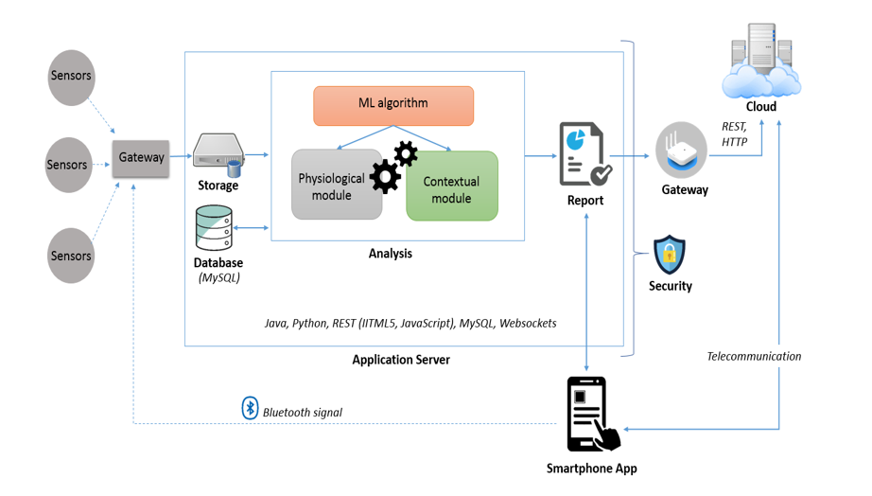
Implementation Architecture
13/27

Slide 14
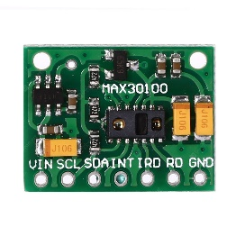
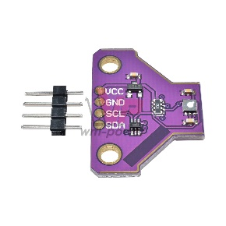
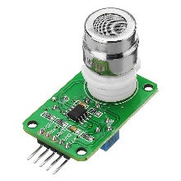

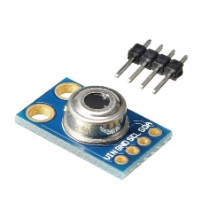
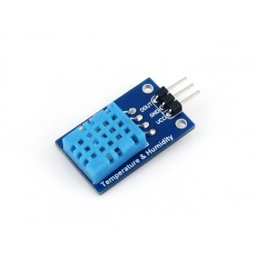
Sensors
Physiological Status Measurement
Environmental Status Measurement
MLX90614ESF AAA - Human body temperature sensor
HT11 - Temperature and humidity sensor.
2017
2016
2018
MAX30100 – Oximetry and Heart-Rate Monitor Sensor
MG811 - Carbon Dioxide Gas CO2 Sensor Module Detector sensor
SGP30 Gas Sensor - Multi Pixel Indoor Air Quality Measurement Sensor
14/27

Slide 15
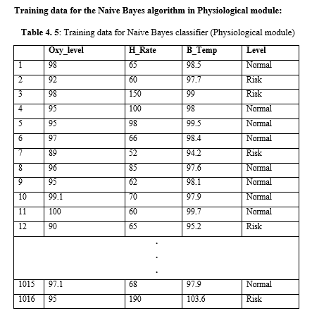
Physiological Data Classification
Oxygen level in blood (%) | Physiological Condition
95 – 100 | Normal
Less than 95 | Below normal
Oxygen level in human body classification
Heart Rate (BPM) | Physiological Condition
60 -100 | Normal
100 < | Raising
190 | Maximum
Heart Rate in human body classification
Body temperature (°F) | Physiological Condition
97.7 – 99.5 °F | Normal
99.5 or 100.9 °F < | Fever
95.0 °F > | Hypothermia
Body temperature in human body classification
15/27

Slide 16
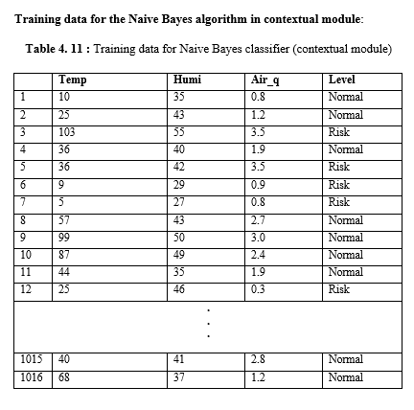
Contextual Data Classification
Temperature (°F) | Physiological Condition
10 – 100 | Normal
greater than 100 | Risk
Less than 10 | Risk
Temperature in the context classification
Humidity (%) | Physiological Condition
31 -50 | Normal
greater than 50 | Risk
Less than 31 | Risk
Humidity in the context classification
TVOC (mg/m³)¹³ | Air quality
Less than 0.3 | Very good
1.0 – 3.0 | Good
Greater then 3.0 | Poor
Air Quality in the context classification
16/27

Slide 17
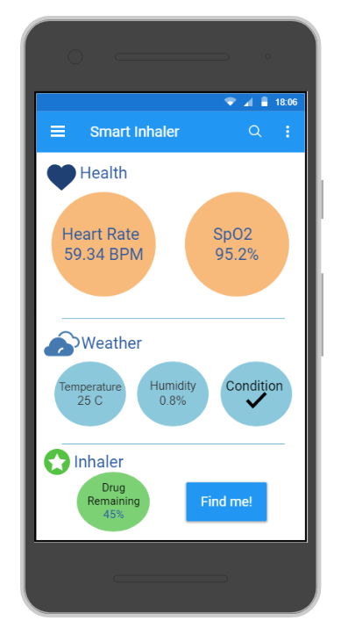
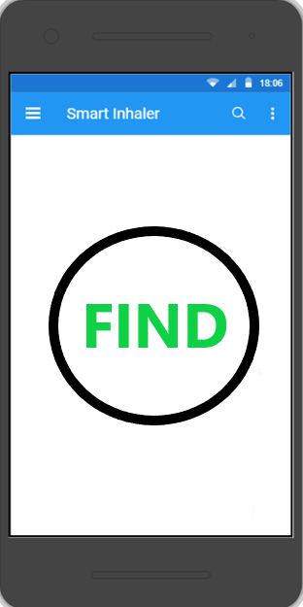
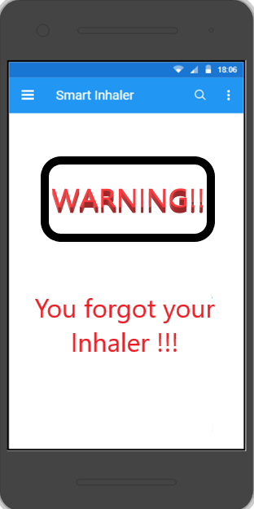
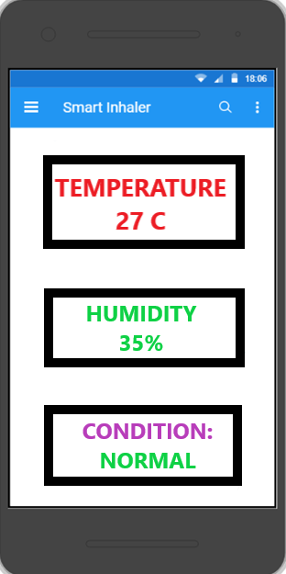
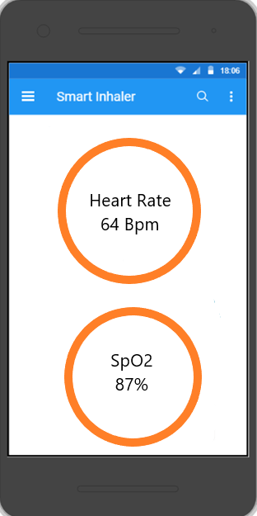
Prototype Views of App
Smartphone App view
Finding Option UI
Notification Option UI
Environmental Situation UI
Physiological Situation UI
17/27

Slide 18
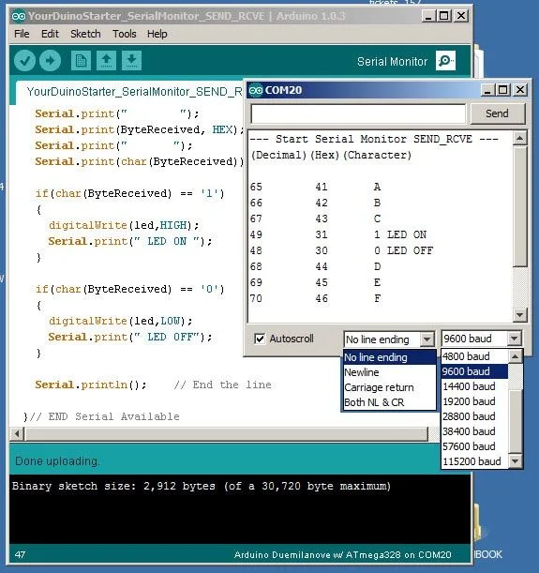
Notification Giving Option for App
Considering Arduino or Raspberry Pi
BLE (Bluetooth Low Energy)
The Arduino IDE,
Arduino Serial Monitor function,
18/30

Slide 19
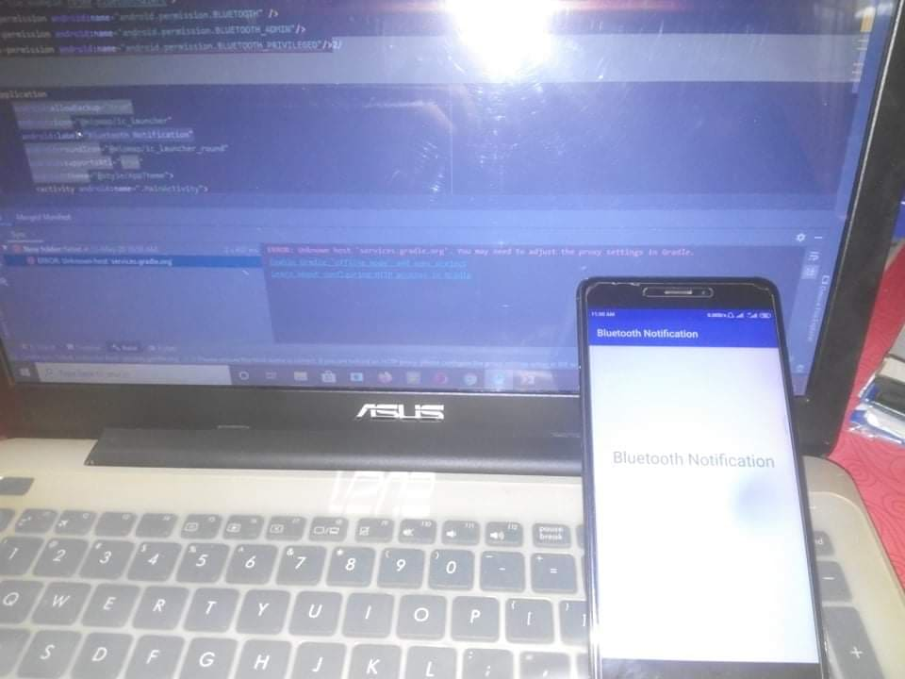
Considering Laptop as Smart Inhaler
We try to connect with the Bluetooth of Laptop,
Paired & Disconnected Notification.
19/27

Slide 20
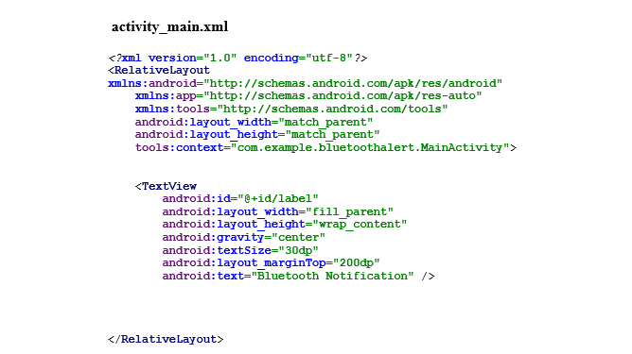
Coding for Android App Development
20/27

Slide 21
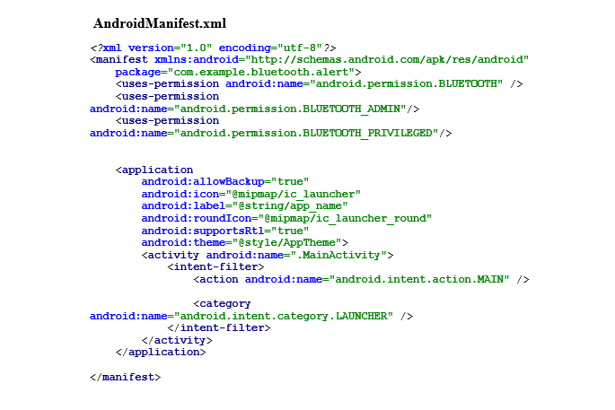
21/27

Slide 22
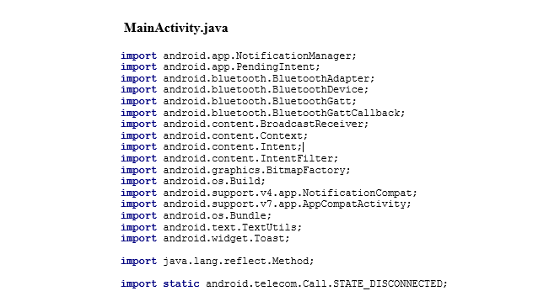
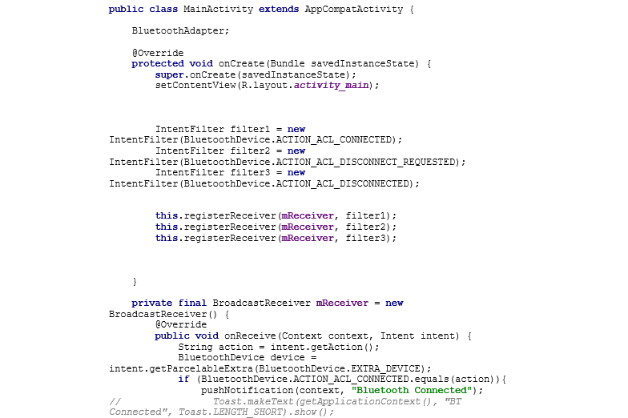
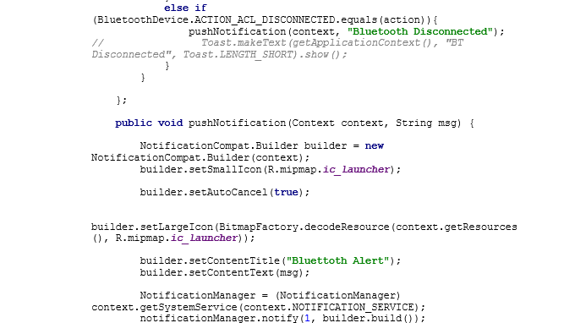
1
2
3
22/27

Slide 23

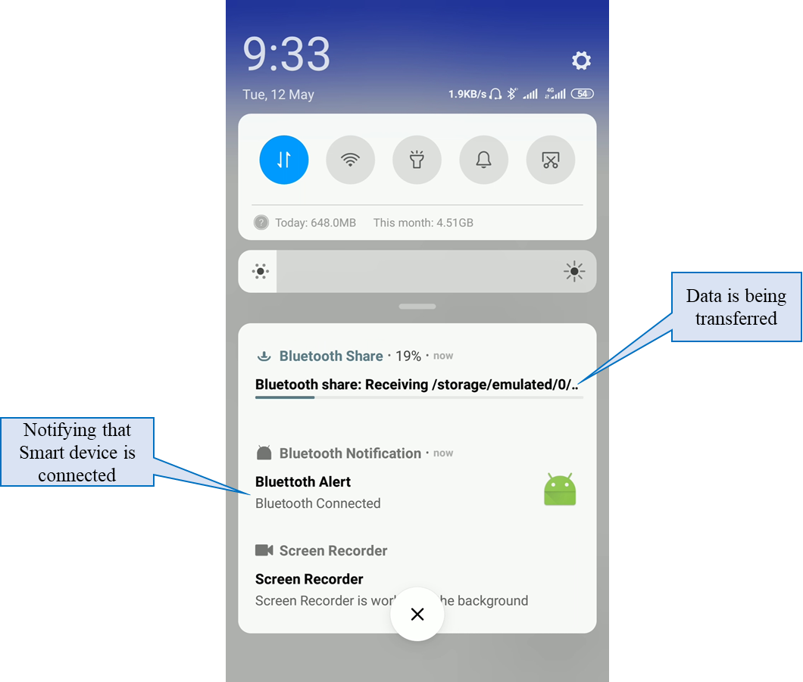
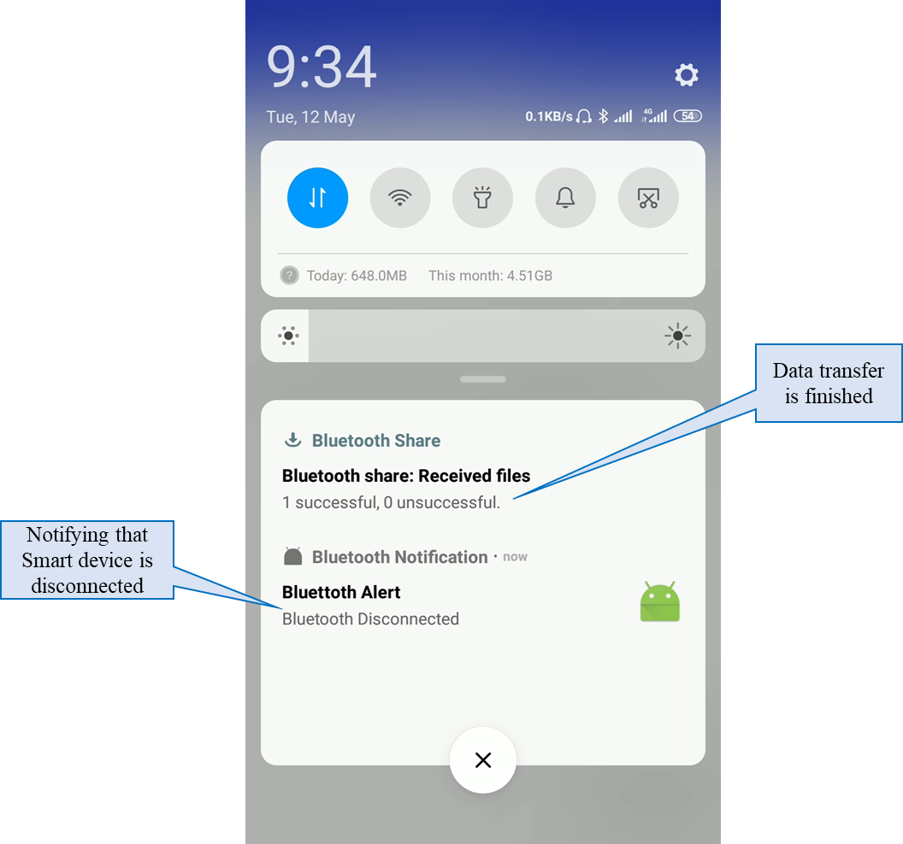
Smartphone Notifications
Smartphone Application
Connected State of Notification
Disconnected State of Notification
23/27

Slide 24
Conclusion
For Notification giving part
Developed
System
Architectures
Smartphone Application
Developed
Future Work
For Context-awareness
For Implementation Architecture
Due to the situation we could not do it all
Other Options
24/27

Slide 25
Acknowledgement
MD. Rezaur Rahman Siddiqui
Group Product Manager
UniHealth Ltd.
Expertise in:
He is the Head of Production Management.
He is responsible for creating and developing medical related items technologically.
25/27

Slide 26
References
[1] Asthma- & allergilinjen. Inhalers for children. Available at: http://www. astmaochallergilinjen.se/barnastma/inhalatorer-for-barn/ [Accessed 24 Feb 2020].
[2] Major V, Rosen M, Mushin WW. "Methoxyflurane as an obstetric analgesic: a comparison with trichloroethylene". BMJ. 2 (5529): 1554–61.
[3] Cohen, J. Solis (1876). Inhalation in the treatment of disease: its therapeutics and practice. Philadelphia: Lindsay & Blakiston.
[4] Nick Baumann (July–August 2011). "Why You're Paying More to Breathe". Mother Jones.
[5] Romagnoli A, Busque L, Power DJ. "The "analgizer" in a general hospital: a preliminary report". Canadian Journal of Anesthesia. 17 (3): 275–8.
[6] "Asthma Group Concerned "Green" Inhalers May Not be as Effective | ksdk.com | St. Louis, MO". ksdk.com. Retrieved 2010-11-21.
[7] Hickey, A.J., ed. (2004). Pharmaceutical Inhalation Aerosol Technology (2nd ed.). NY: Marcel Dekker.
[8] Asthma UK and British Lung Foundation Partnership, Smart Inhaler. 2020. Available at: https://www.asthma.org.uk/advice/inhalers-medicines-treatments/inhalers-and-spacers/smart-inhalers/ [Accessed 24 Feb 2020].
[1] Asthma- & allergilinjen. Inhalers for children. Available at: http://www. astmaochallergilinjen.se/barnastma/inhalatorer-for-barn/ [Accessed 24 Feb 2020].
[2] Major V, Rosen M, Mushin WW. "Methoxyflurane as an obstetric analgesic: a comparison with trichloroethylene". BMJ. 2 (5529): 1554–61.
[3] Cohen, J. Solis (1876). Inhalation in the treatment of disease: its therapeutics and practice. Philadelphia: Lindsay & Blakiston.
[4] Nick Baumann (July–August 2011). "Why You're Paying More to Breathe". Mother Jones.
[5] Romagnoli A, Busque L, Power DJ. "The "analgizer" in a general hospital: a preliminary report". Canadian Journal of Anesthesia. 17 (3): 275–8.
[6] "Asthma Group Concerned "Green" Inhalers May Not be as Effective | ksdk.com | St. Louis, MO". ksdk.com. Retrieved 2010-11-21.
[7] Hickey, A.J., ed. (2004). Pharmaceutical Inhalation Aerosol Technology (2nd ed.). NY: Marcel Dekker.
[8] Asthma UK and British Lung Foundation Partnership, Smart Inhaler. 2020. Available at: https://www.asthma.org.uk/advice/inhalers-medicines-treatments/inhalers-and-spacers/smart-inhalers/ [Accessed 24 Feb 2020].
26/27

Slide 27
Thank You Everyone

